Slide 1
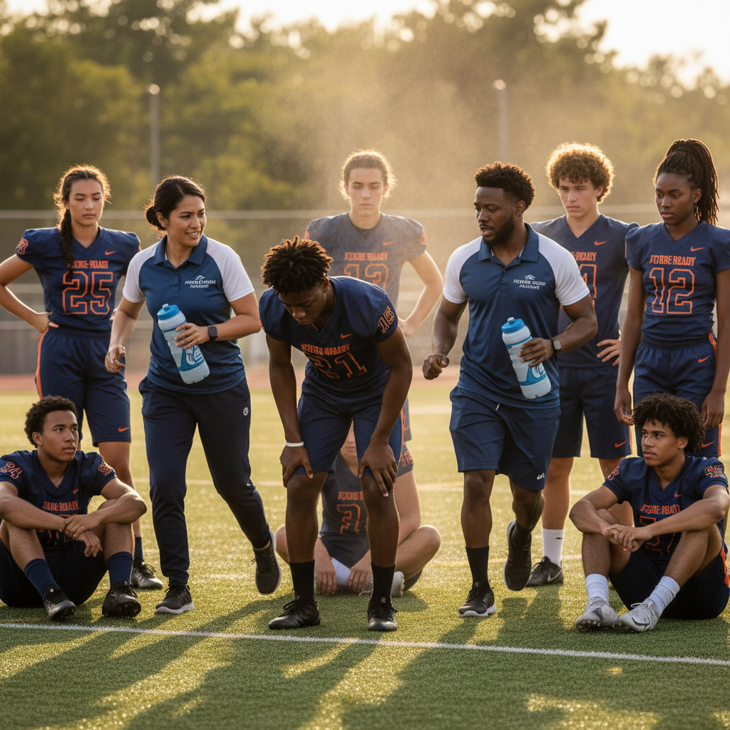
ModelIt!
Student Lesson
Why Do Athletes Collapse in the Heat?
Modeling Homeostasis and the Body's Breaking Point
NGSS: HS-LS1-3
9th Grade — Level 1: Foundations
1/9

Slide 2
What You Will Learn Today
Learning Goals
* Model how the body uses feedback mechanisms to regulate core temperature during physical activity
* Explain how sweat rate, hydration, and exertion interact to maintain or disrupt homeostasis
* Predict the conditions under which an athlete's thermoregulation system will fail
* Analyze how external factors like hydration can shift the tipping point of heat-related illness
Key Vocabulary
Homeostasis
The body's ability to maintain stable internal conditions — like temperature, blood sugar, and pH — even when the external environment changes
Thermoregulation
The biological process by which the body maintains its core temperature within a safe range, primarily through sweating and blood vessel dilation
Feedback Mechanism
A biological loop where the output of a system influences its own input — negative feedback stabilizes, positive feedback amplifies
Heat Exhaustion
A dangerous condition caused by the body's inability to cool itself, marked by heavy sweating, rapid pulse, dizziness, and potential organ damage
2/9

Slide 3

The Big Question
Why do some athletes collapse during games while others playing the same sport are fine?
Modeling Homeostasis and the Body's Breaking Point. Today we'll build a MODEL to discover the answer!
3/9

Slide 4

Today We Will Build a Model!
A model helps us understand complex systems!
1. LOCATE
Identify the COMPONENTS (parts) of the system
2. ESTABLISH
Connect them with RELATIONSHIPS (+ or -)
3. VISUALIZE
Build your model in ModelIt!
4. EVALUATE
Run SIMULATIONS to test scenarios
5. REVISE
Improve your model based on evidence
4/9

Slide 5

Activity 1: Sort the Components
Sort these components into EXTERNAL (inputs from outside) and INTERNAL (inside the system):
Your Components:
* Core Temperature
* Sweat Rate
* Hydration Level
* Physical Exertion
Think: Which components can we control? Which happen on their own?
5/9

Slide 6
Activity 2: Connect with Arrows
Draw arrows to show HOW components affect each other:
(+) POSITIVE Relationship
When one goes UP, the other goes UP too
(-) NEGATIVE Relationship
When one goes UP, the other goes DOWN
Think About It:
When Physical Exertion is high and Hydration Level drops, what happens to the body's ability to produce sweat and regulate Core Temperature? Where does the feedback loop break?
6/9

Slide 7
Activity 3: Run the Simulation!
Test these scenarios in ModelIt!
Moderate Exercise, Well Hydrated
Set Physical Exertion to moderate and Hydration Level to high — observe how the body maintains homeostasis
Intense Exercise, Dehydrated
Set Physical Exertion to maximum and Hydration Level to low — observe the cascade to heat exhaustion
Gradual Dehydration
Start Hydration Level high and gradually reduce it while keeping exertion steady — find the tipping point
Watch the activity graphs change!
[ModelIt Platform Screenshot - Simulation Results Graph]
7/9

Slide 8
What Did We Discover?
Our Model Showed Us:
* The body's thermoregulation is a negative feedback loop — rising temperature triggers sweating, which cools the body back down
* Dehydration breaks the feedback loop because the body can't produce sweat without water, causing temperature to spike
* There's a critical tipping point where the cooling system fails — core temperature rises uncontrollably, leading to heat stroke
* Individual differences in fitness, acclimatization, and hydration habits explain why some athletes collapse while others don't
Answer: Athletes collapse when their body's negative feedback loop for temperature regulation breaks down. High exertion generates enormous heat, which normally triggers sweating to cool the body. But when hydration drops too low, the body can't produce enough sweat. Core temperature spirals upward past the tipping point, and the athlete's organs start shutting down — that's heat stroke.
8/9

Slide 9

STEM Challenge: Design a Heat Safety Alert System
YOUR ENGINEERING MISSION
Design a wearable or sideline monitoring system that tracks athlete biometrics and alerts coaches before heat-related illness occurs.
The Challenge:
A high school athletic department has had three heat-related incidents in two years. The principal has hired your team to design a monitoring system that can predict when an athlete is approaching dangerous territory and alert the coaching staff before collapse occurs.
Think Like an Engineer:
* What biometric indicators would your system monitor in real time?
* How would you determine the threshold for triggering an alert?
* What role does individual variation play in setting safety limits?
REAL CAREER CONNECTION: Sports Physiologists study how the body responds to physical activity and environmental stress. They work with professional sports teams, military programs, and research institutions, earning $60,000–$120,000/year. The skills you're using TODAY are the same ones they use on the job!
9/9

